Slide 1


An Introduction to Domain
Driven
Design
By Don W.

Slide 2
Outline
Why do we need it?
What is it?
How to implement it?

Slide 3
Why do we need DDD?

Slide 4
Tackling Complexity in the Heart of Software
E. Evans
Software Complexity
A mismatch between the mental model, and the problem domain
Separation of developers from business experts invites unnecessary indirection
Lack of a common language
Note:
If your business model can be described by the database operations create, read, update, and delete (CRUD)
Then you may not need DDD

Slide 5
What?
am·bi·gu·i·ty
/ˌambəˈɡyo͞owədē/
noun
noun: ambiguity plural noun: ambiguities
the quality of being open to more than one interpretation; inexactness.: "we can detect no ambiguity in this section of the Act""ambiguities in such questions are potentially very dangerous".

Slide 6
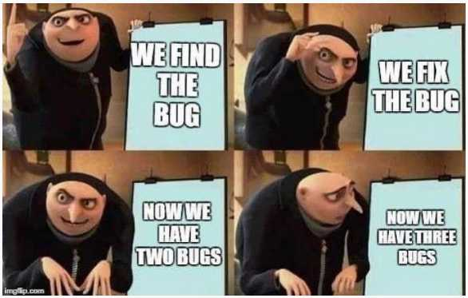
Complexity
1

Slide 7
What is DDD?

Slide 8
A way of thinking
What does this really mean?
Why does this happen?
Aligning software development efforts with the interests of the business.
Focused on building an object oriented model of the domain using a common language and then protecting that model from corruption.

Slide 9
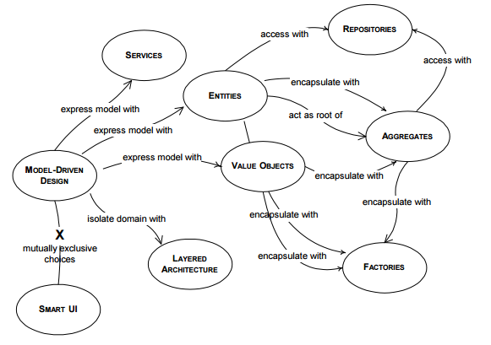
A set of Guidelines

Slide 10
Implementation

Slide 11
Focus on the domain
Look at business process, find the inputs and outputs
Pin down an agreed upon set of terms the describe the problem space within a context
Realize that DDD is most effective when philosophy and patterns come together
DDD is a journey
Be willing to refactor when deeper domain understanding shifts the model

Slide 12
Questions?

